Slide 1
HUD 811 Project-Based Rental Assistance
Notes:
Lorraine

Slide 2
HUD 811 Project Rental Assistance Demonstration Program
Required Partnership Agreement
Department of Housing & Community Development
Dept. of Health & Mental Hygiene/Medicaid
Dept. of Disabilities
July 2012 - MD applied for HUD 811 PRA
35 states applied
February 2013 – MD received award for $10.9 million
13 states received award
2 states with RCSC grant received award (MD & TX)
Notes:
Diane

Slide 3
Why is 811 PRA Important?
New funding for ongoing rental assistance
Case managers are central to success
Decent, affordable housing for people with disabilities and extremely low income
Integrated units – means there are no more than 25% for people with disabilities in any development
Safe, decent housing units near transportation and services
Notes:
Lorraine

Slide 4
HUD & CMS
Sec 811 PRA
HUD and CMS form partnership
MDOD manages web-based eligibility system; processes for tenant selection & referral; track unit availability
DHCD reaches out to developers and funds units; pays rent subsidies; ensures housing quality standards; ensures HUD program compliance
DHMH (and associated Case Managers) enroll applicants, make services available, assists with transition and manages tenant issues
MPAH
DHCD
DHMH
MDOD
Developers & Property Management Companies
Service Providers & Case Managers
Housing Developers and Property Managers partner with Case Managers for continued assistance
Notes:
Lorraine

Slide 5
811 PRA Program
Goal
150 permanent supported housing units
Program Type
Project–based rental assistance
Located in multi-family housing developed with affordable housing development funds
Integrated – no more than 25% of units designated for people with disabilities
Eligible Applicants:
Medicaid recipients with disabilities eligible for services
Head of household age 18 and under age 62
Access to services
Income at or below 30% Area Median Income (AMI) – includes SSI level income
Rent Contribution
30% of income for rent and utilities combined
Notes:
Elaine - Talk about definition of integrated (see handout), multi-family and AMI and project-based

Slide 6
MD 811 PRA Target Population
Non-elderly adults with disabilities, between 18 and 62 years of age, with income below 30% of AMI who are receiving Medicaid services (waiver & State Plan)
Recipients who are institutionalized: nursing facility, ICF/ID, state psychiatric hospital or hospital where assistance is available under the State Medicaid
Recipients moving to independent renting: DDA Community Pathways Waiver participants moving from Group Homes/Alternative Living Units to independent renting and MHA Residential Rehabilitation Program participants
Recipients who are homeless (as defined by HEARTH Act)
Recipients at risk of institutionalization due to current housing situation: i.e. change in health status, change in available supports, deplorable housing conditions
Prioritized in this order:
Actually homeless
Imminent risk of homelessness
Homeless under other Federal statutes (i.e. unaccompanied youth/families with youth)
Fleeing domestic violence
Notes:
Jennifer - Add 4 HEARTH Act definitions; add HUD definition of disability – put these on handout

Slide 7
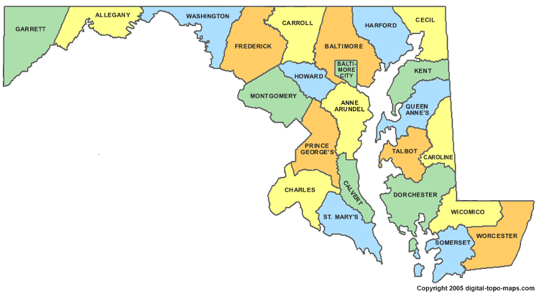
811 PRA Unit Locations
Priority locations:
Baltimore metro area
Anne Arundel County
Baltimore City
Baltimore County
Carroll County
Harford County
Howard County
Queen Anne’s County
Washington metro area
Frederick County
Montgomery County
Prince George’s County
Calvert County
Charles County
Goal
50% Split between Priority Locations where demand is strong
70% One-Bedroom Units
30% Two-Bedroom
Notes:
Elaine

Slide 8
Operational Overview
Funding Structure:
Sec 811 Program funds cover the difference between rent household can afford and Fair Market Rent for up to 5 years;
DHCD will award PRA Demo funds in conjunction with its existing financing programs including LIHTC and State Rental Housing Funds; and
$1,000,000 in DHMH funds held in trust by DHCD to fund the housing subsidy to participants for up to 6 months if Sec 811 PRA is not renewed and funding is no longer available from HUD
Administration:
DHCD will award PRA Demo Funds using both a NOFA process and through its competitive funding rounds for LIHTCs and RHFs;
DHCD will operate the rental subsidy for participating tenants;
DHMH and MDOD will operate the system for registering units, referring eligible program applicants, and providing ongoing voluntary long-term community supports.

Slide 9
Voluntary Support Services
5 Medicaid Waivers
Living At Home – age 18 to 64
Older Adults Waiver – age 50 and older
Traumatic Brain Injury – adults with TBI
Community Pathways and New Directions – people with a developmental disability
Case management through Medicaid services
Assistance through CILS for people with no service funded case management
Notes:
Jennifer

Slide 10
Roles & Expectations of Case Managers
Outreach
Provide program information
Enter outreach activities into 811 PRA tracking system
Referral
Register as user with Social Serve
Identify and overcome challenges – criminal background and credit, housing history
Keep information current in MPAH referral system
Transition Planning
Coordinate and facilitate access to services and housing
Obtain needed documentation (i.e. birth certificate, benefit letter)
Assist with applications, reasonable accommodations
Housing Retention
Ongoing contact with tenant
Work with property manager, tenant and MFP HD to resolve issues
Notes:
Jennifer

Slide 11
Enrollment
Eligibility list
Web-based system – roll out projected for Fall of 2013
Case manager must enroll participant
Transition planning must begin early and continue to be updated
6 month advance notice for new units
2 month notice on turnover
Notes:
Jennifer

Slide 12
Documentation
Notes:
Martha

Slide 13
Documentation
Credit check & criminal background performed by property manager
Two “never” convictions
Lifetime sex offender registration requirement
Methamphetamine production on federally-assisted housing property
Other restrictions
Currently engaging in illegal drug activity, fugitive felons, parole violators, evicted from federally-assisted housing due to drug-related criminal activity within last 3 years
Reasonable cause to believe person is a danger
Notes:
Martha

Slide 14
Case Manager Training and Support
Training
Person Centered Planning for Housing
PRA Users Guide
Use of Social Serve System
811 Outreach Tracking System
Reasonable Accommodations
Tenant Training
Technical Assistance
MPAH Advisory Group
MDOD
MFP
Notes:
Martha

Slide 15
Next Steps
HUD Notice H2013-24 “Section 811 Project Rental Assistance (PRA) Occupancy Interim Notice”
Published on 8/23
DHCD is reviewing and will post on Web Site
Cooperative Agreement
Expected to be signed by DHCD and HUD by the end of October, 2013
Program implementation will begin once it is signed
Unit Selection
Initial units identified in early 2014 as part of October 29, 2013 Round
Mid-2014 NOFA for existing CDA-financed units wit expectation for occupancy availability in late 2014 or early 2015
Outreach
DHCD will share additional information and an implementation schedule when available
DHCD, DHMH and MDOD will provide demos and more detailed overview of the referral and case management system once the Cooperative Agreement is finalized

